Slide 1
ETIKA PROFESI TEKNOLOGI INFORMASI
BAB VI

Slide 2

Selamat Datang di Era Informasi

Slide 3
BERIKUT ADA DATA-DATA YANG PERLU KITA CERMATI BERSAMA

Slide 4
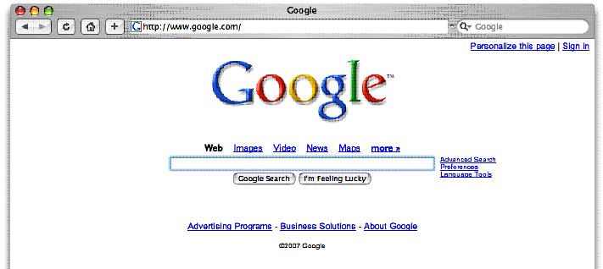
Setiap bulannya ada 2,7 miliar search di Google

Slide 5

Jumlah pesan tertulis yang
diterima & dikirim setiap hari
melebihi jumlah
total populasi di planet ini

Slide 6

Lebih dari 3000 buku baru
dipublikasi setiap harinya

Slide 7
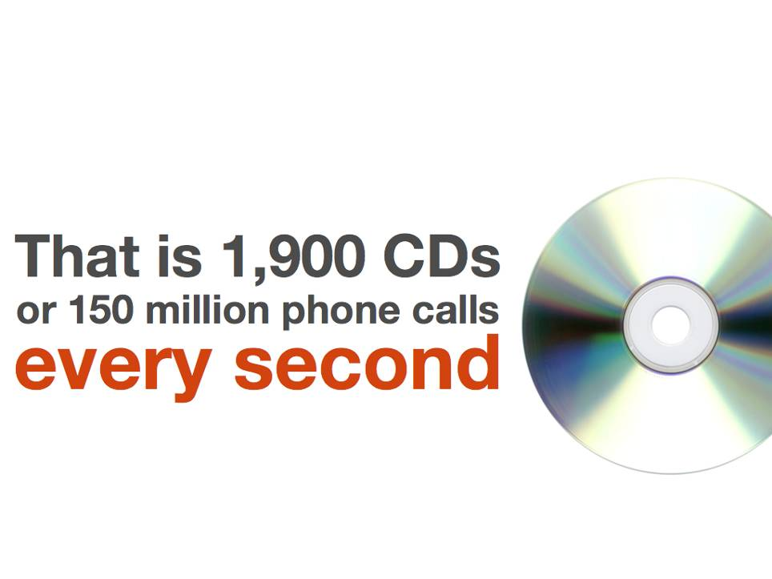
diproduksi 1.900 CD
150 juta panggilan telepon
setiap detik

Slide 8

diperkirakan 40 exabytes (4.0 x 10¹⁰)
informasi baru (unik)
diproduksi worldwide tahun lalu

Slide 9
apa yang mahasiswa pelajari pada semester 1
akan kadaluarsa saat mereka
2x
berada di semester 5

Slide 10
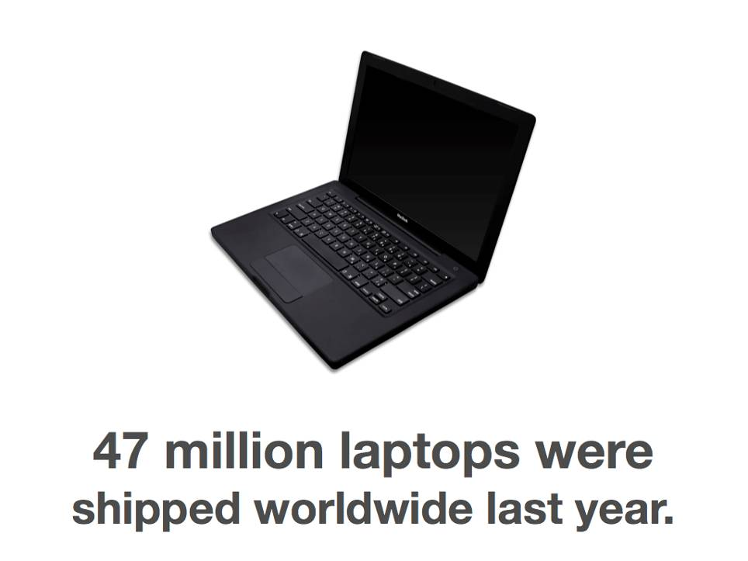
47 juta laptop terjual tahun lalu

Slide 11
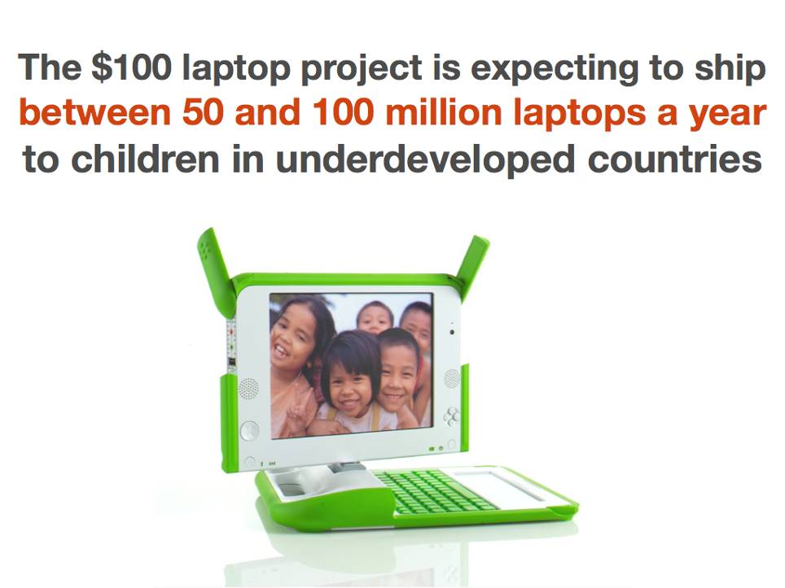
project laptop $100 diperkirakan terkirim
antara 50 sd 100 juta laptop setahun
untuk anak-anak negara terbelakang

Slide 12

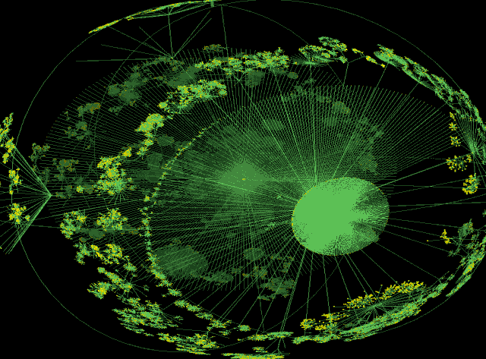
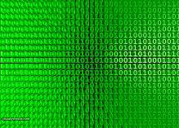
Era Informasi
Jutaan komputer
Networks
+
+
Data

Slide 13
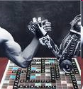
Komputer = Universal Tools
Komputer mengerjakan hampir apa saja
Komputer tidak perlu tidur
Komputer tidak lelah
Komputer tidak pulang rumah karena sakit, atau cuti untuk refreshing / rekreasi
Seringkali lebih efisien daripada manusia

Slide 14
Komputer vs Manusia
Karenanya, dengan alasan ekonomis, kecenderungan untuk mengganti manusia dengan komputer sangat tinggi
Teller bank, operator telepon, jasa pengetikan, graphic artist, satpam, buruh perakitan

Slide 15
Komputer vs Manusia
Bahkan profesional seperti dokter, pengacara, guru, akuntan, psikolog menemukan bahwa komputer dapat melakukan beberapa tugas mereka lebih efektif.

Slide 16

Komputer “membantu” Manusia
Pilot “dilengkapi dengan” auto-pilot
Warung “dilengkapi dengan” mesin pembuat minuman
Mereka menjadi sekedar pengamat pasif & penekan tombol

Slide 17
Profesi TIK
Programmer
Operator Entri Data
Software Engineer
System Analyst
Guru TI
Server Administrator
GUI Desainer
Database Administrator
Web Content Manager
Webmaster
Instruktur TI
Software Engineer
Hardware Engineer
Multimedia Desainer

Slide 18
TIK Tingkatkan Kapasitas Intelektual
Dengan bantuan teknologi informasi & komunikasi kecerdasan dan kapasitas manusia meningkat

Slide 19
PAPA = 4 Isu Etika Era Informasi
Privacy (kerahasiaan)
Accuracy (kebenaran)
Property (kepemilikan)
Accessibility (hak akses)

Slide 20
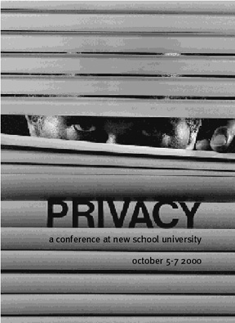
Isu 1: Privacy (kerahasiaan)
Informasi seseorang atau terkait seseorang mana yang:
Boleh dibuka kepada orang lain?
Dalam kondisi/syarat apa?
Apa yang dapat seseorang sembunyikan dari orang lain?

Slide 21
Pengganggu Privacy
Perkembangan TI
Meningkatkan komunikasi,komputasi dan pengawasan
Pertumbuhan nilai informasi untuk pengambilan keputusan

Slide 22
Kasus 1: Apakah perlu melihat?
Pekerjaan Anda: database administrator di data backup center.
Anda boleh mencek semua data??
Data: pengetahuan/informasi ttg perusahaan swasta
Notes:
You are the DBA at a backup data center.Your company provides back up and
redundant data services for several different businesses.Your job is simply to back
up the data and make sure the data replication technology is working appropriately.
Is it acceptable for you to check out all of the information in the databases
of all of your clients?
Conservative Privacy is a very important matter with clients.They are
entrusting you with their sensitive data and are not expecting you to snoop
Chapter 8 • Database Administration
through it. Be professional and do not inspect or review the data entrusted
to you.
Liberal Part of the job of an administrator in a backup location is to verify
data integrity, which will require you to review the data from time to time.
There is nothing wrong with reviewing the data. If, however, you divulge
information about the data, that is another story.
SUMMARY
As the administrator of back up and replication services, reviewing data
entrusted to you should be done when necessary as part of your job
function. Reviewing data for nosey purposes should not be done; however,
there are no rules against it in most cases.

Slide 23
Konservatif:
Privasi hal penting bagi klien Anda. Mereka percayakan data sensitif mereka, dan berharap Anda tidak mengintipnya.
Liberal:
Bagian dari tugas administrator adalah memverifikasi integritas data. Tidak masalah untuk melihat data. Kecuali kalau Anda membocorkannya
Kesimpulan:
Sebagai administrator untuk backup dan replikasi data, mereview data yang dipercayakan kepada Anda dilakukan seperlunya bila terkait dengan pekerjaan.
Notes:
You are the DBA at a backup data center.Your company provides back up and
redundant data services for several different businesses.Your job is simply to back
up the data and make sure the data replication technology is working appropriately.
Is it acceptable for you to check out all of the information in the databases
of all of your clients?
Conservative Privacy is a very important matter with clients.They are
entrusting you with their sensitive data and are not expecting you to snoop
through it. Be professional and do not inspect or review the data entrusted
to you.
Liberal Part of the job of an administrator in a backup location is to verify
data integrity, which will require you to review the data from time to time.
There is nothing wrong with reviewing the data. If, however, you divulge
information about the data, that is another story.
SUMMARY
As the administrator of back up and replication services, reviewing data
entrusted to you should be done when necessary as part of your job
function. Reviewing data for nosey purposes should not be done; however,
there are no rules against it in most cases.

Slide 24
Kasus 2: Sekuriti vs Invasi Privacy?
Pekerjaan Anda: database administrator di ISP.
Anda bertugas mengamati trafik pengguna
Data: log web akses
Problem: Apakah Anda dibenarkan mereview akses data sehingga Anda mengetahui hal-hal yang dilakukan pengguna?
Notes:
Knowledge of Private Personal
Information – Security vs. Invasion of Privacy?
The Internet Service Provider (ISP) you are a DBA for collects detailed data
about users’ online activities. It keeps track of the Web sites users go to. Is it
appropriate for you as the DBA to review this data and see who is accessing
pornographic sites or have other unusual sites that could be embarrassing to the
ISP user?
Conservative You are entrusted with sensitive information about ISP
users and should never abuse that trust. Reviewing usage is not appropriate.
Liberal As a DBA for an ISP company, you should review the usage of its
users. It is your responsibility from a security point of view. If the users are
accessing illegal sites, your company could be at risk.This is a security function
of your job.
SUMMARY
Reviewing sensitive information about ISP clients is a touchy issue. By
reviewing what sites they visit, you may obtain information that
someone is trying to learn how to build a bomb or other terrorist
activity, which could target your company and hurt other people.
However, customer information must have some level of privacy. Check
the customer agreement the clients have with your company to determine
what you can legally do with client information to balance out
your role of security versus invasion of personal privacy.

Slide 25
Konservatif:
Anda dipercayai menjaga informasi sensitif para pengguna ISP. Jangan lukai kepercayaan itu.
Liberal:
Tugas Anda untuk menjaga keamanan. Jika pengguna mengakses situs ilegal, perusahaan Anda akan beresiko.
Kesimpulan:
Tipis! Cek perjanjian dengan customer, apakah Anda legal melakukannya. Demi keseimbangan antara sekuriti dan privacy.
Notes:
Knowledge of Private Personal
Information – Security vs. Invasion of Privacy?
The Internet Service Provider (ISP) you are a DBA for collects detailed data
about users’ online activities. It keeps track of the Web sites users go to. Is it
appropriate for you as the DBA to review this data and see who is accessing
pornographic sites or have other unusual sites that could be embarrassing to the
ISP user?
Conservative You are entrusted with sensitive information about ISP
users and should never abuse that trust. Reviewing usage is not appropriate.
Liberal As a DBA for an ISP company, you should review the usage of its
users. It is your responsibility from a security point of view. If the users are
accessing illegal sites, your company could be at risk.This is a security function
of your job.
SUMMARY
Reviewing sensitive information about ISP clients is a touchy issue. By
reviewing what sites they visit, you may obtain information that
someone is trying to learn how to build a bomb or other terrorist
activity, which could target your company and hurt other people.
However, customer information must have some level of privacy. Check
the customer agreement the clients have with your company to determine
what you can legally do with client information to balance out
your role of security versus invasion of personal privacy.

Slide 26
Kasus 3: Informasi Gaji Rekan Anda.
Pekerjaan Anda: database administrator.
Anda menjaga integritas & konsistensi data.
Data: data pegawai bersama gajinya
Problem: Anda menemukan variasi gaji yang berbeda, tetapi menurut Anda tidak sesuai dengan pekerjaan dan prestasi. Teman Anda salah satu yang mungkin dirugikan.
Bolehkah Anda memberitahu teman Anda?
Notes:
Conservative Disclosing information about salaries is not up to you and
is in breach of your responsibility of protecting the data as DBA.You are in
a trusted role as a DBA and should not disclose information to the
employees within the company for any reason whatsoever.This type of
behavior is completely unacceptable.
Liberal Since the company you are employed by is doing something a
little shady with their employees, you do not owe them anything. Friends
are friends, and they should know that they are being seriously jilted.Tell
your friends but ask them not to spill the beans so that you can provide
them with future information. While you are at it, you should check the
salaries of other IT personnel to make sure you are being paid what you
deserve.
SUMMARY
The role of the DBA provides many challenges. The DBA has access to
detailed client records, credit card information, employee payroll data,
and much more. In some cases, there are legal and government requirements
for how this data should be handled in regard to privacy. In other
cases, there are no legal requirements or company policies and it is up
to the DBA to determine what their own personal ethics are in relation
to the information they have at their fingertips.

Slide 27
Konservatif:
Keputusan ttg gaji bukan tanggung-jawab Anda. Anda tercaya sebagai DBA, jangan lukai kepercayaan bos Anda.
Liberal:
Teman adalah teman. Mereka berhak tahu bahwa mereka dirugikan. Tetapi beritahu teman Anda, bahwa jangan telan pil itu, sehingga Anda dapat memberitahu mereka untuk informasi di masa depan.
Kesimpulan:
DBA memiliki akses yang detail terhadap kredit card, gaji, dll. Dalam beberapa kasus tidak ada peraturan khusus dari perusahaan, ini semua tergantung kepada etika profesional Anda.
Notes:
Conservative Disclosing information about salaries is not up to you and
is in breach of your responsibility of protecting the data as DBA.You are in
a trusted role as a DBA and should not disclose information to the
employees within the company for any reason whatsoever.This type of
behavior is completely unacceptable.
Liberal Since the company you are employed by is doing something a
little shady with their employees, you do not owe them anything. Friends
are friends, and they should know that they are being seriously jilted.Tell
your friends but ask them not to spill the beans so that you can provide
them with future information. While you are at it, you should check the
salaries of other IT personnel to make sure you are being paid what you
deserve.
SUMMARY
The role of the DBA provides many challenges. The DBA has access to
detailed client records, credit card information, employee payroll data,
and much more. In some cases, there are legal and government requirements
for how this data should be handled in regard to privacy. In other
cases, there are no legal requirements or company policies and it is up
to the DBA to determine what their own personal ethics are in relation
to the information they have at their fingertips.

Slide 28

Isu 2: Accuracy (kebenaran)
Siapa yang bertanggung-jawab kepada:
Autentikasi, ketepatan, dan keakuratan informasi?
Siapa yang harus menanggung bila ada error di informasi dan bagaimana kesalahan itu berakibat kepada sistem secara keseluruhan?

Slide 29
Isu 3: Accuracy (kebenaran)
Mis-informasi dapat berakibat fatal terhadap kehidupan seseorang.
Khususnya saat bila pihak yang memiliki informasi tak akurat tersebut diuntungkan dengan adanya power dan otoritas.

Slide 30
Data Tanpa Integritas = Data Terkontaminasi
Memberbaiki data dengan pembersihan tidak sulit.
Tapi mahal.
Perlu specialist.
Notes:
Cleansing data
isn’t quite as hard, but it is as expensive. It requires specialists to write
hundreds of scripts to test for this and that condition
The operations folks have responsibility
too; suppose you were trying to enter the amount of a payment and
you were told to enter round numbers, $99 instead of $99.99 because it
is faster. How long would the database remain accurate? A minute? One
of the times of greatest danger for a database is during a maintenance
update. All too often, the maintenance coder removes critical checks and
balances, either to get the job done faster or because they do not understand
the total system.
The DBA must be the keeper of the gate; the
database is only valuable to the organization if its data has integrity. Your
responsibility includes investigating every possible source of database
contamination.

Slide 31
Kasus 1: Rubah data untuk tujuan marketing
Problem: Anda mendapat tugas memasukkan data dan menggambar grafik untuk laporan keuangan. Bos Anda meminta untuk menghapus tampilan yang rendah, karena akan menyebabkan laporan akan jelek secara keseluruhan.
Notes:
You are pulling this quarter’s data together for the corporate financial report that
will go out to the investors.Your boss asks you to remove some of the low figures
because they take down the whole report. Do you do it?
Conservative Changing financial data can get you into a mess of
trouble. Refuse to remove the low figures and explain that you do not want
to put yourself at legal risk.
Liberal In this issue, if your boss wants to remove a whole section of data
from the report that is his prerogative. Just make sure that it does not make
the report inaccurate. It is up to him to limit the results on the report. Be
careful not to venture into the area of altering or deleting data.
SUMMARY
Unfortunately, this type of request happens all of the time when issuing
financial or marketing data. Not reporting on sections of data when it is
not required is less of an issue than actually altering data. This problem
ventures into the area of legal issues and should be handled with utmost
care and responsibility. Keep in mind the law and your own personal
ethics when making the decision to format financial or marketing data.

Slide 32
Konservatif:
Merubah data akan menyebabkan masalah-masalah lain yang berkelanjutan. Tolak permintaan bos Anda dan jelaskan bahwa Anda tidak ingin terlibat dalam masalah hukum.
Liberal:
Itu adalah hak prerogatif bos Anda. Pastikan saja bahwa itu tidak membuat data menjadi tidak akurat, dengan hanya membatasi laporan. Jangan terjebak dalam merubah atau menghapus data.
Kesimpulan:
Sayangnya hal ini sering terjadi. Tidak melaporkan sesi data tertentu lebih baik daripada merubah data. Selalu ingat hukum dan etika profesional Anda. Karena apa yang Anda lakukan akan menjadi bahan pijakan suatu keputusan.
Notes:
You are pulling this quarter’s data together for the corporate financial report that
will go out to the investors.Your boss asks you to remove some of the low figures
because they take down the whole report. Do you do it?
Conservative Changing financial data can get you into a mess of
trouble. Refuse to remove the low figures and explain that you do not want
to put yourself at legal risk.
Liberal In this issue, if your boss wants to remove a whole section of data
from the report that is his prerogative. Just make sure that it does not make
the report inaccurate. It is up to him to limit the results on the report. Be
careful not to venture into the area of altering or deleting data.
SUMMARY
Unfortunately, this type of request happens all of the time when issuing
financial or marketing data. Not reporting on sections of data when it is
not required is less of an issue than actually altering data. This problem
ventures into the area of legal issues and should be handled with utmost
care and responsibility. Keep in mind the law and your own personal
ethics when making the decision to format financial or marketing data.

Slide 33

Isu 4: Property (kepemilikan)
Siapa pemilik informasi?
Bagaimana harganya?
Bagaimana informasi itu mengalir?
Siapa yang boleh mengakses?

Slide 34

Intellectual Property

Slide 35
Property
Sebuah informasi mungkin memerlukan harga yang tinggi untuk memproduksinya.
Sekali diproduksi secara digital, maka ia mudah direproduksi dan didistribusikan, tanpa merusak produk aslinya.

Slide 36

Isu 4: Accessibility (hak akses)
Informasi apa yang dapat diperoleh oleh seseorang atau organisasi?
Dalam kondisi seperti apa?

Slide 37
Standar Etika Profesi IT
ACM
“Code of Ethics and Professional Conduct”
Computer Ethics Institute
“The Ten Commandements of Ethic's”
Data Processing Management Association
“Code of Ethics and Standards of Conduct”

Slide 38
10 Etika Komputer (Institut Etika Komputer)
Jangan menggunakan komputer untuk membahayakan orang lain.
Jangan mencampuri pekerjaan komputer orang lain.
Jangan mengintip file orang lain.
Jangan menggunakan komputer untuk mencuri.
Jangan menggunakan komputer untuk bersaksi dusta.

Slide 39
10 Etika Komputer (Institut Etika Komputer)
Jangan menggunakan atau menyalin perangkat lunak yang belum kamu bayar.
Jangan menggunakan sumber daya komputer orang lain tanpa otorisasi.
Jangan mengambil hasil intelektual orang lain untuk diri kamu sendiri.
Pikirkanlah mengenai akibat sosial dari program yang kamu tulis.
Gunakanlah komputer dengan cara yang menunjukkan tenggang rasa dan rasa penghargaan.

